Slide 1
UNRAVELING DNA DAMAGE-INDUCED AGEING THROUGH TRANSCRIPTOMIC ANALYSIS ACROSS DNA REPAIR-DEFICIENT MODELS
Authors: Hasmik Chilingaryan, Swati, James Joy, Temitope Ayano, Gloria

Slide 2
Table of contents
01
02
03
04
Objectives
Methodology
Defines the project's aim and outlines the six specific goals for data processing, analysis, and biomarker discovery.
Details the two-track computational pipeline, covering data retrieval, quality control, DESeq2 analysis, pathway enrichment, and the Random Forest ML framework.
Results analysis
Conclusions
Presents the key findings from differential expression, diagram comparisons, functional pathway enrichment, and the predictive biomarkers identified by ML model.
Provides a concise summary of the findings, confirming DNA damage mechanisms while noting the divergence of DNA repair defect signatures from natural ageing.

Slide 3
Background
Ageing results from cumulative molecular damage, with DNA damage as a key contributor.
Defects in NER proteins (e.g., ERCC1-XPF, CSA) cause progeroid syndromes, highlighting genomic instability as a driver of ageing.

Slide 4
Hypothesis
DNA repair deficiencies leave a distinct transcriptomic signature of accelerated ageing.

Slide 5
Objectives
01
02
Identify shared and unique DEGs and pathways in ERCC1-XPF/CSA mutant mice and naturally aged tissues.
Apply Machine Learning to discover robust predictive biomarkers of DNA damage-induced ageing.

Slide 6
Defective NHEJ
Dysfunctional telomeres
Truncated p53
Tissue Stem Cell Depletion
Unrepaired DNA damage
p53 activation
Senescence/Apoptosis
Ageing
Defective HR
Direct Impairment of Cellular Function
Genome Instability
Figure 1: A Model for the Role of Unresolved DNA Lesions in Ageing. Unrepaired DNA damage from defective repair (such as defective TC-NER in our models) triggers p53 activation, leading to senescence and depletion of tissue stem cells. This process, along with direct functional impairment, results in accelerated ageing.[3]

Slide 7
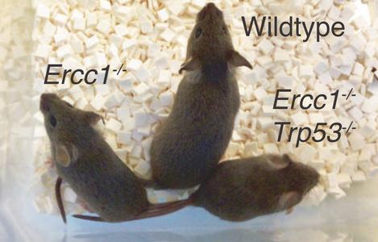
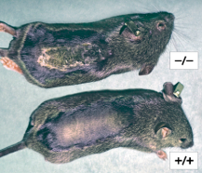
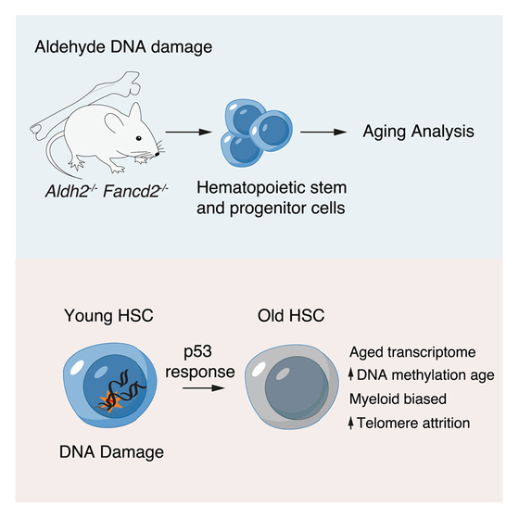

Dataset Overview
Dataset 1 (GSE206778)
RNA-seq, Mouse
Biological Groups: ERCC1 -/-, p53 -/-, WT
Sample Tissues: HSCs, Hepatocytes, PGCs
Sample Size: 40 [4]
Dataset 2 (GSE288213)
RNA-seq, Mouse
Biological Groups: CSA KO, WT
Sample Tissues: Brain Tissue at D45, 12M, 24M
Sample Size: 30 [5]
Dataset 3 (GSE209742)
Natural Ageing
Normal ageing progression dataset for cross-comparison. [6]

Slide 8

Methodology
Phase 1: Data Foundation (Acquisition & PreProcessing)
Data Retrieval
NCBI GEO & Array Express
Preprocessing &
Quality Control (QC)
Normalised
Expression Matrix
GEO - Normal Ageing
DNA Repair-Deficient KO
Metadata harmonisation
Filtering Low Counts
Outlier Detection
Output: A single, clean data matrix (Genes x Samples).

Slide 9
Phase 2: Parallel Analysis Tracks
Track A:
Differential Expression &
Pathway Analysis
Trach B:
Machine Learning (ML) Framework
Pairwise contrasts
Ko vs WT, aged vs young
Differential Expression (DEG) Analysis
ML Data Preparation
adj. p < 0.05
Standardise
Data
DESeq2
limma
ML Model Training
Differential Expression (DEG) Analysis
Random Forest Classifier
AnnotationDbi
clusterProfiler
ReactomePA
Model Evaluation & Feature Ranking
Output 1
(Signatures)
Output 2
(Biomarkers)
List of Ageing-Related Molecular Signatures
List of Top Predictive Genes

Slide 10
Results: Preprocessing, Differential Expression, and Biomarker Discovery

Slide 11
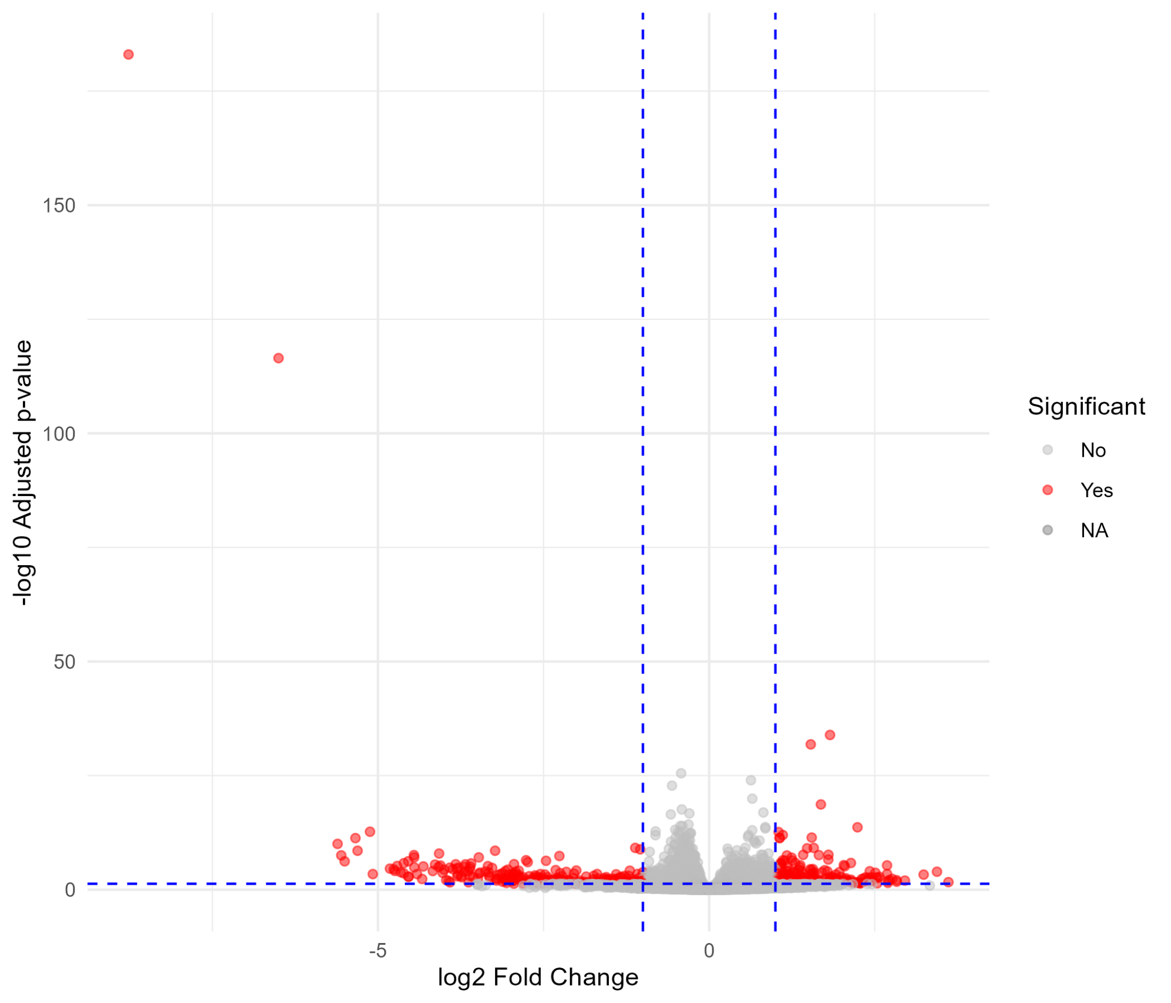
Volcano Plot of ERCC1-XPF Deficiency (GSE206778 Contrast)
The plot shows minimal global differential gene expression, as almost all data points cluster tightly along the log₂ Fold Change = 0 vertical line, indicating few or no genes met the significance threshold.

Slide 12
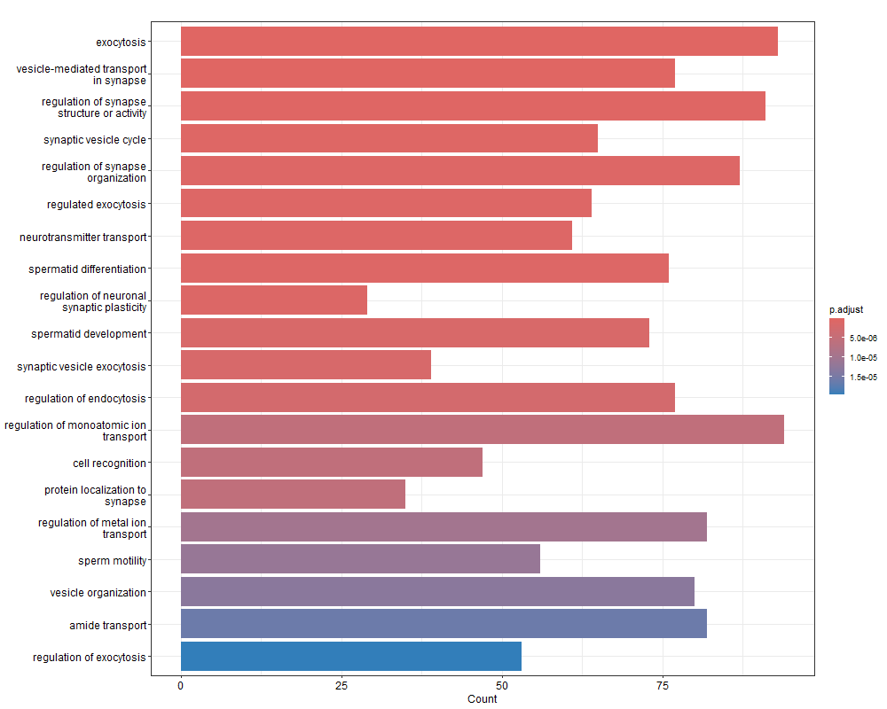
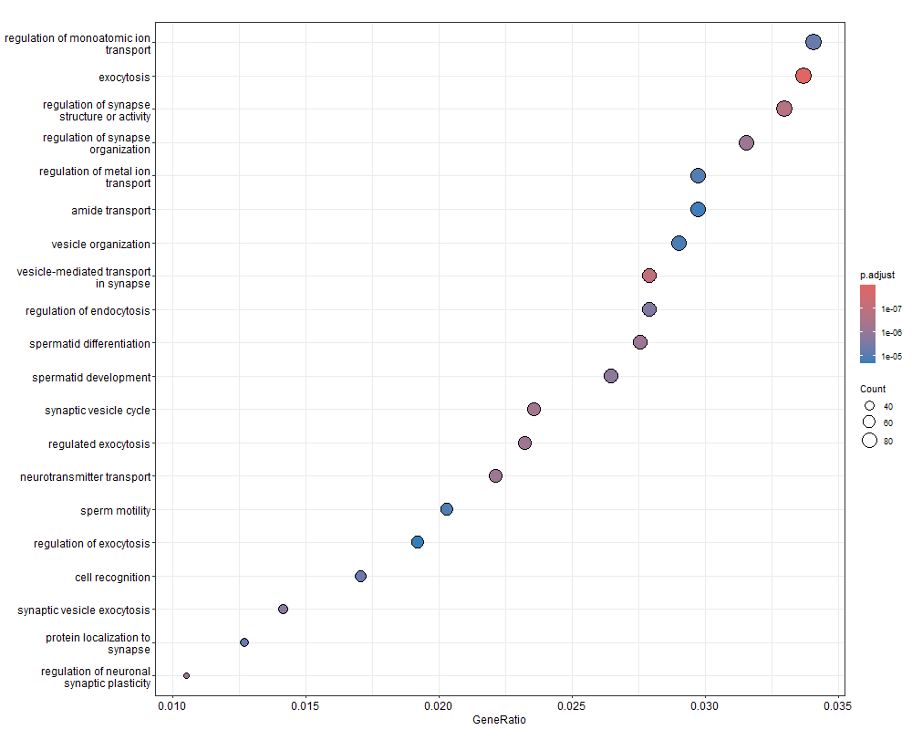
Functional Enrichment Analysis (GSE288213)
The Bar and Dot Plot visualises GO enrichment for CSA KO DEGs, showing GeneRatio (x-axis) and p.adjust (color). The most significantly enriched terms relate to neuronal function and synaptic transport (e.g., regulation of monatomic ion transport, exocytosis), consistent with the CSA model's neurological pathology.

Slide 13
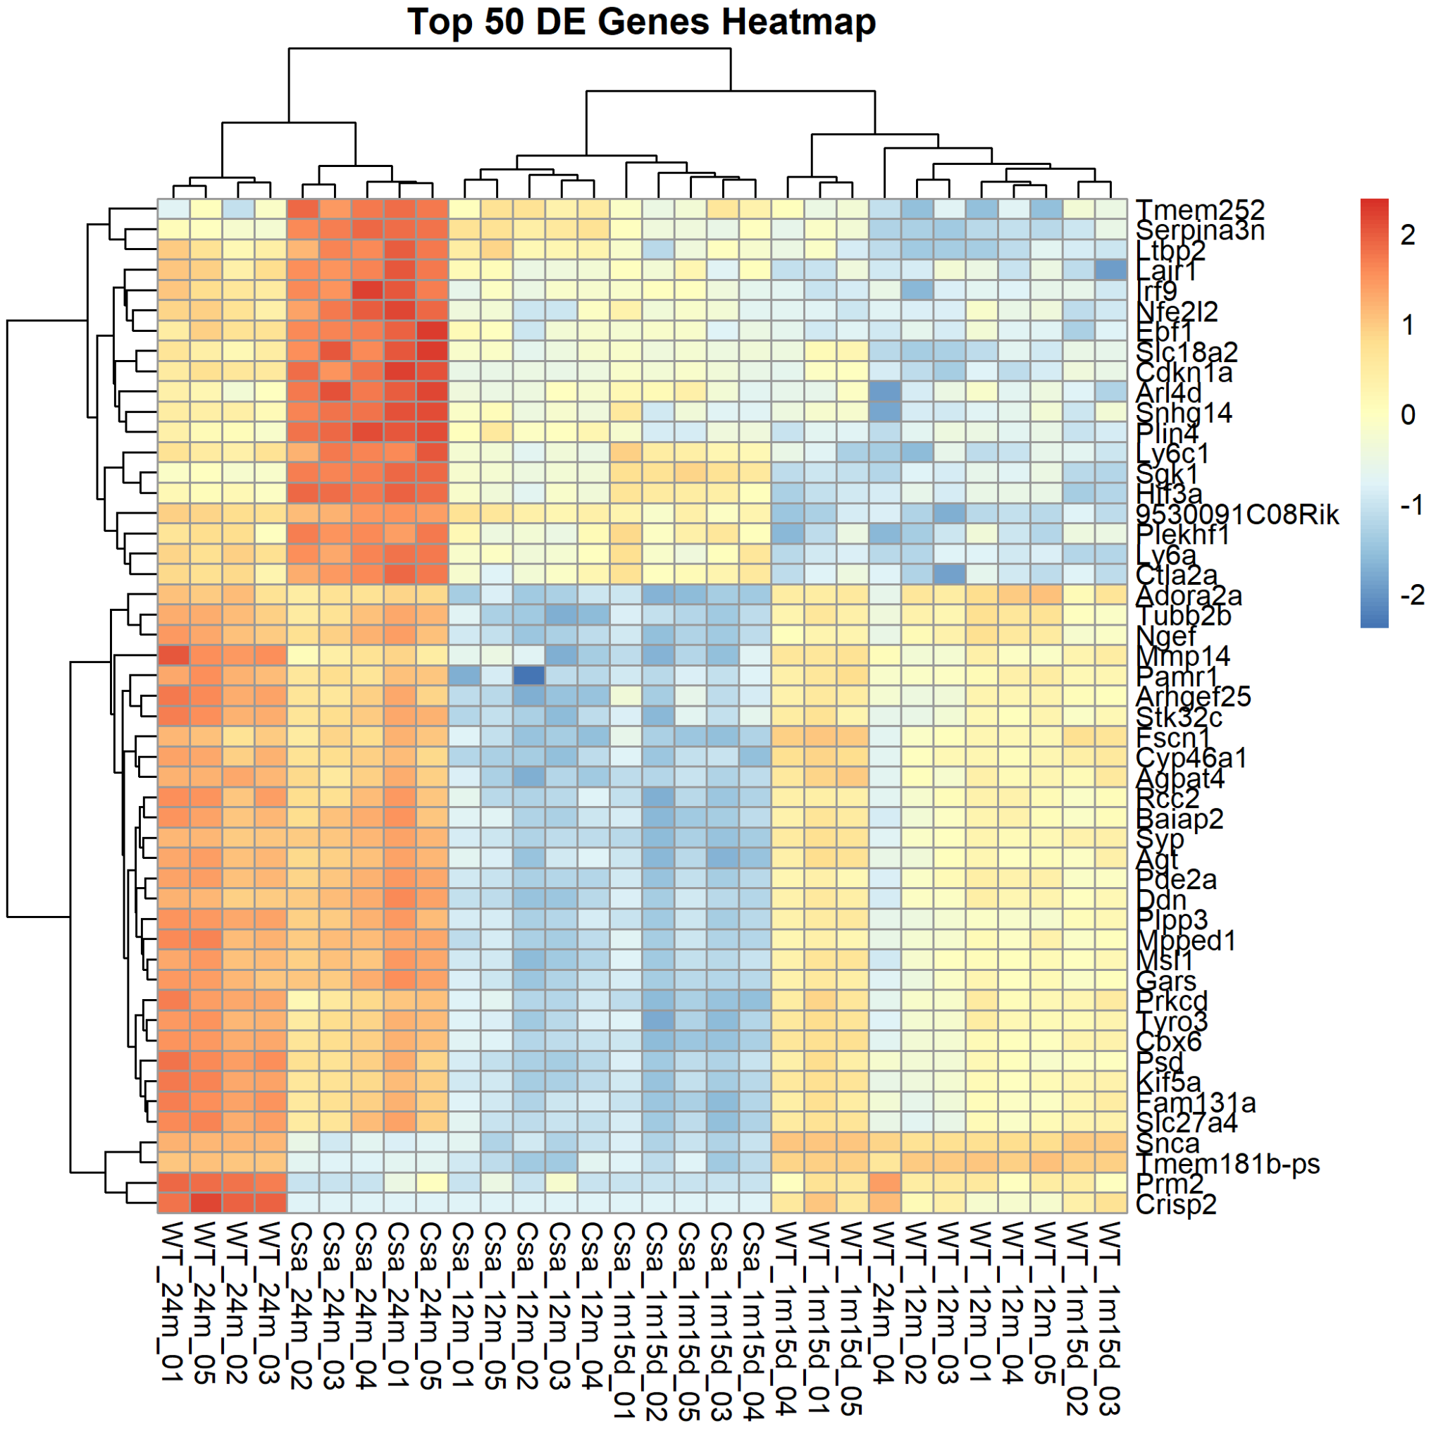
Heatmap of Top DEGs in CSA KO Brain Tissue (GSE288213)
This clustered heatmap of the top 50 DEGs shows that genotype (Csa vs WT) is the primary variance driver. A large gene cluster is consistently upregulated (Red) in Csa KO samples across all three age points, demonstrating a robust, sustained molecular signature of TC-NER deficiency.
Heatmap

Slide 14
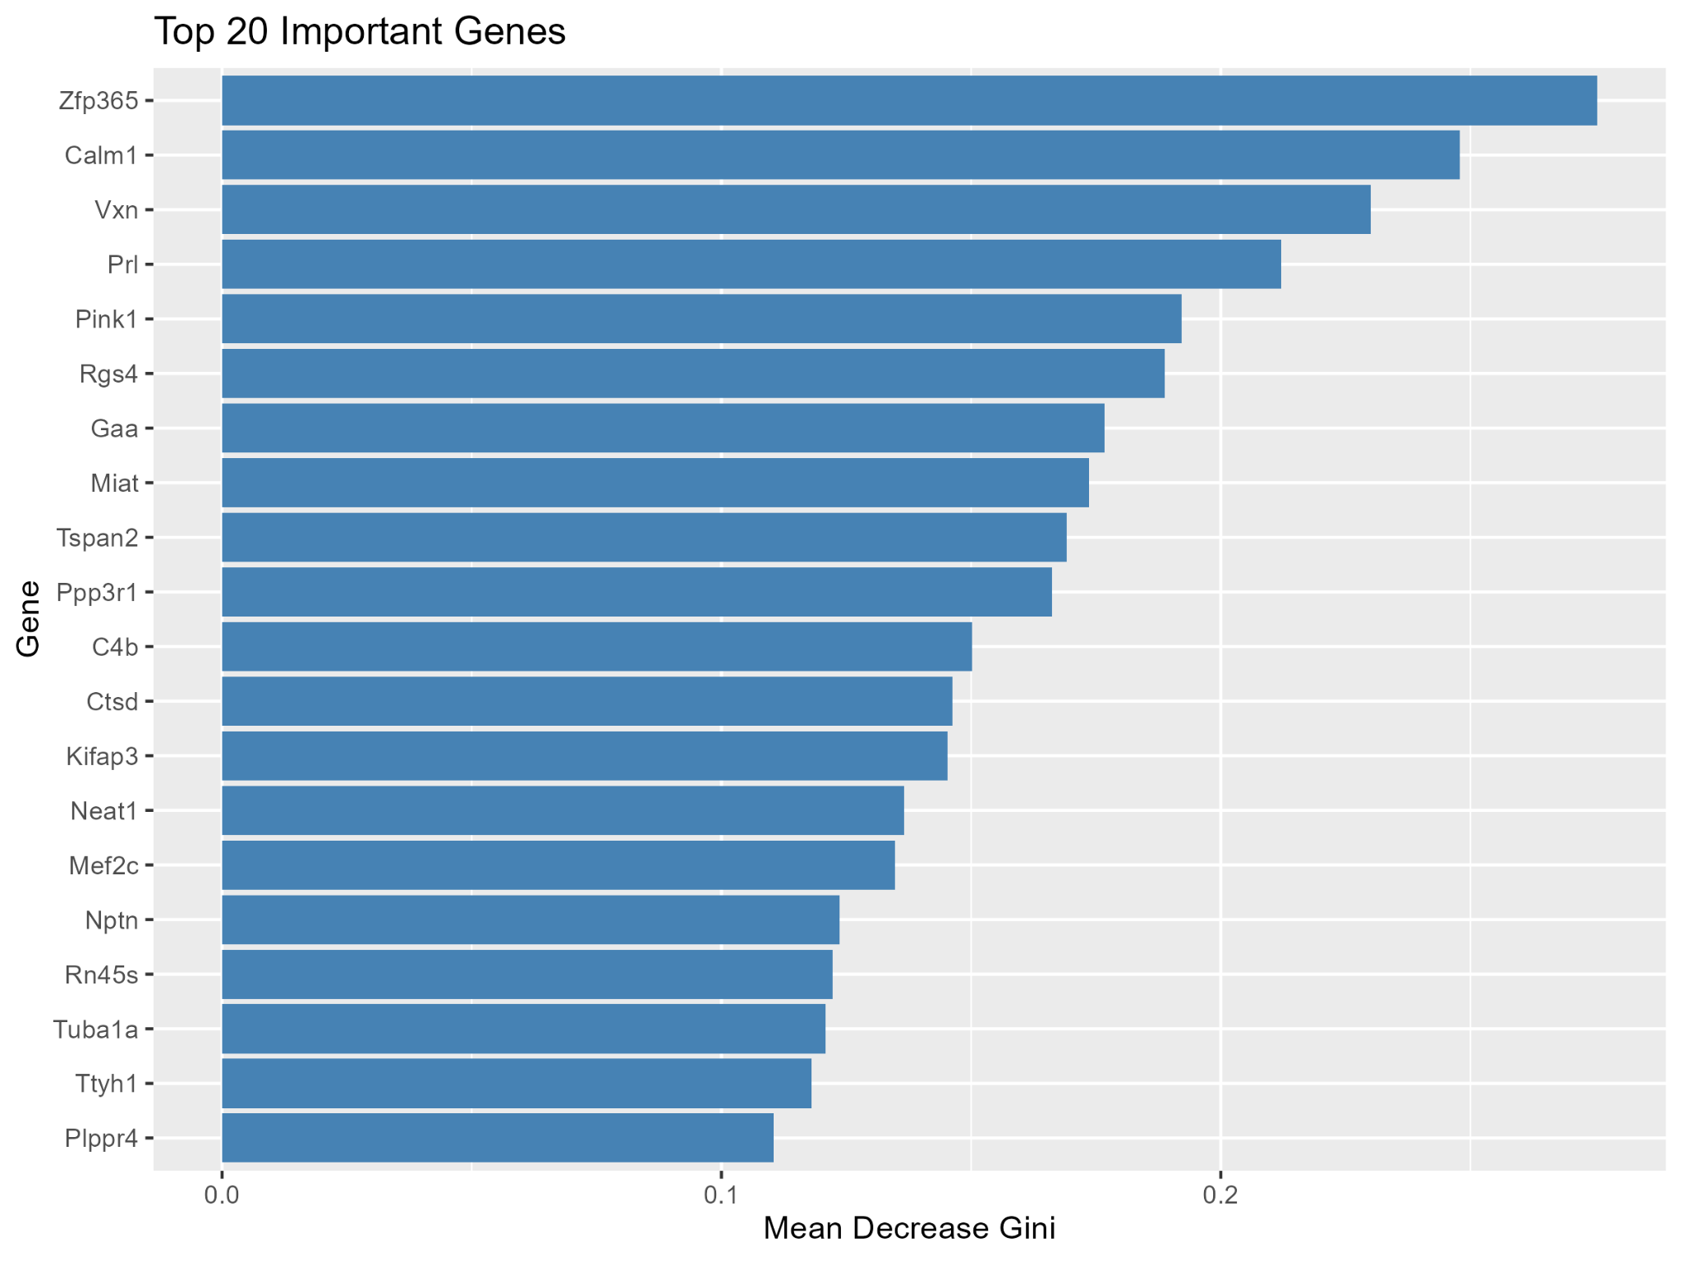
Random Forest Feature Importance (GSE288213)
This bar plot ranks the top 20 genes by Mean Decrease Gini, quantifying their predictive power in distinguishing CSA KO from WT samples. Genes like Zfp365 and Calm1 show the highest predictive value, making them robust candidate biomarkers for TC-NER deficiency, pending DEG cross-validation.

Slide 15
Integrated Outputs
Common ageing signatures shared between DNA repair-deficient and natural ageing models
Tissue-specific differences in DNA damage response
Candidate biomarkers validated across:
DEGs
Pathway enrichment
Machine learning feature importance

Slide 16
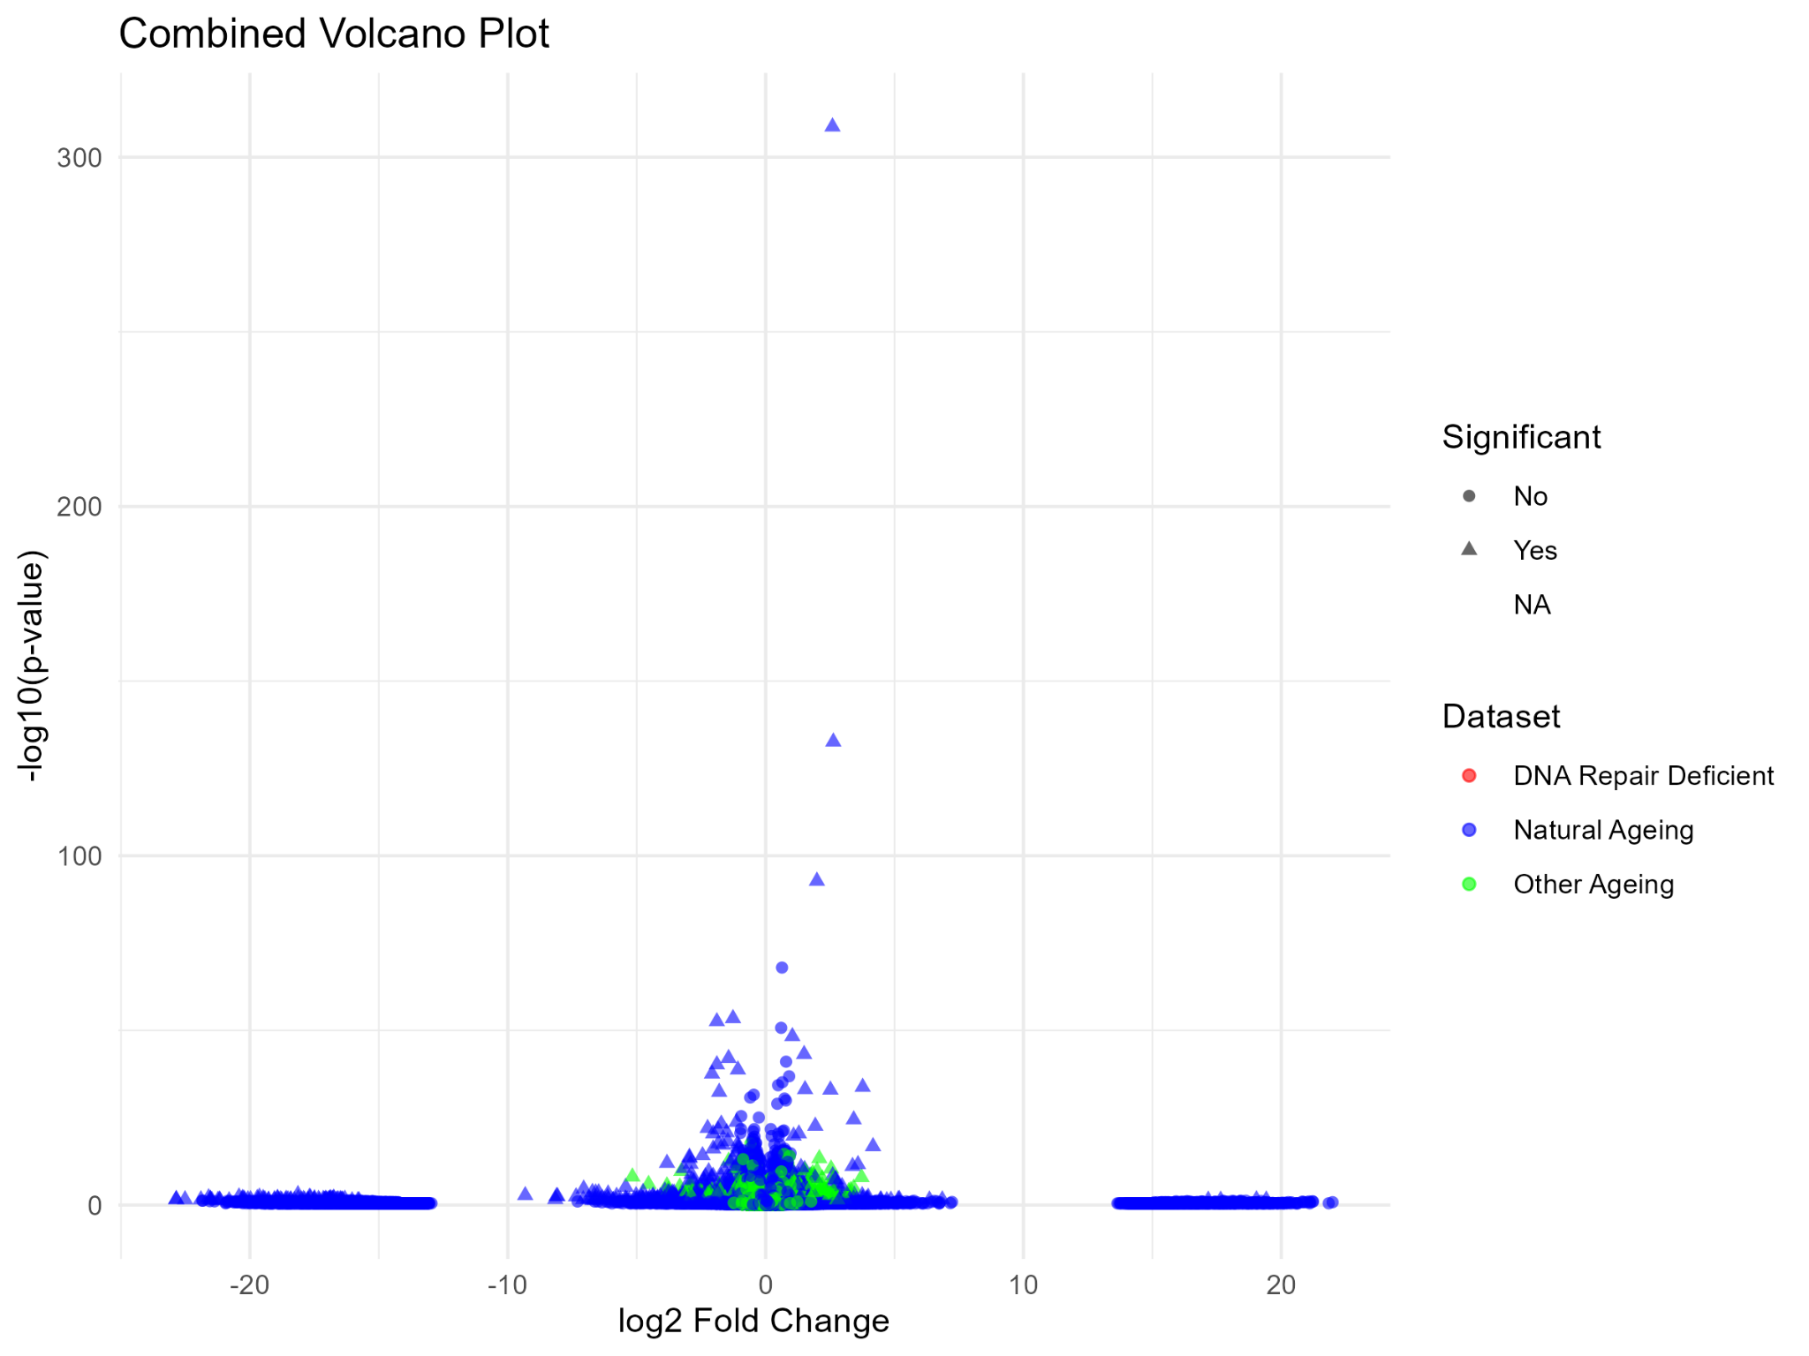
Combined Volcano Plot of All Datasets
This plot overlays DEG results (log₂ Fold Change vs. −log₁₀​ (p-value)) for all three datasets. It confirms a large number of highly significant DEGs in the Natural Ageing and Other Ageing (CSA KO) models (Blue and Green points), with many points achieving scores above 100.

Slide 17
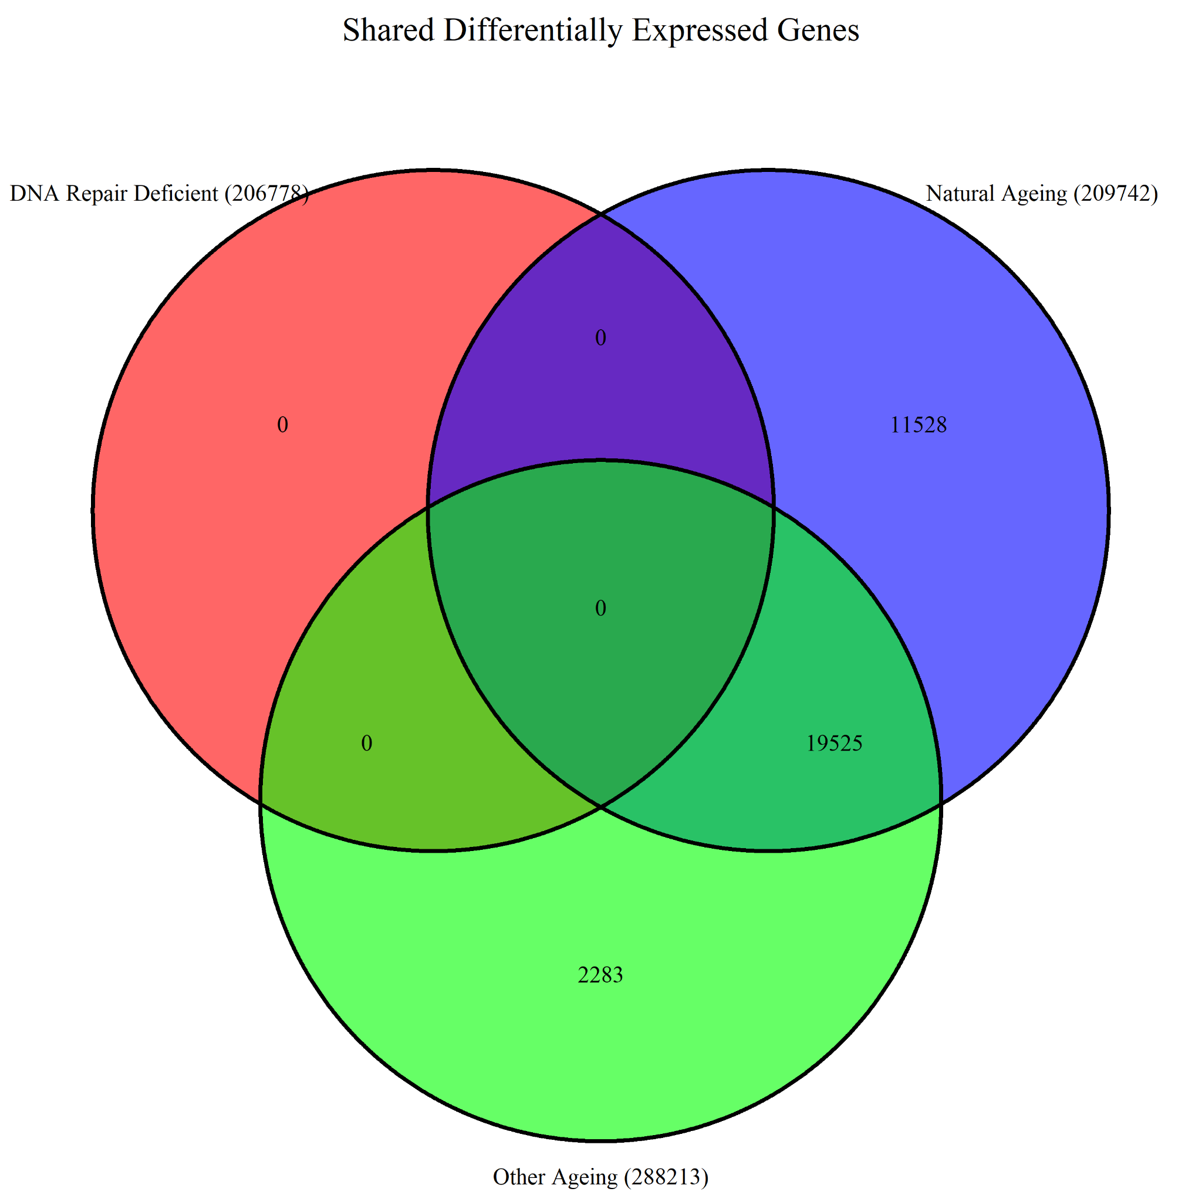
Three-Way Venn Diagram of Shared DEGs
This three-circle diagram compares DEGs from DNA Repair Deficient (GSE206778, Red), Natural Ageing (GSE209742, Blue), and Other Ageing (GSE288213, Green). It yields a critical finding: zero (0) DEGs are shared in the central intersection, suggesting that genetic DNA repair defects drive divergent, distinct pathological signatures rather than simply accelerating a common pathway. Notably, 19,525 DEGs are shared only between Natural Ageing and Other Ageing (CSA KO).

Slide 18
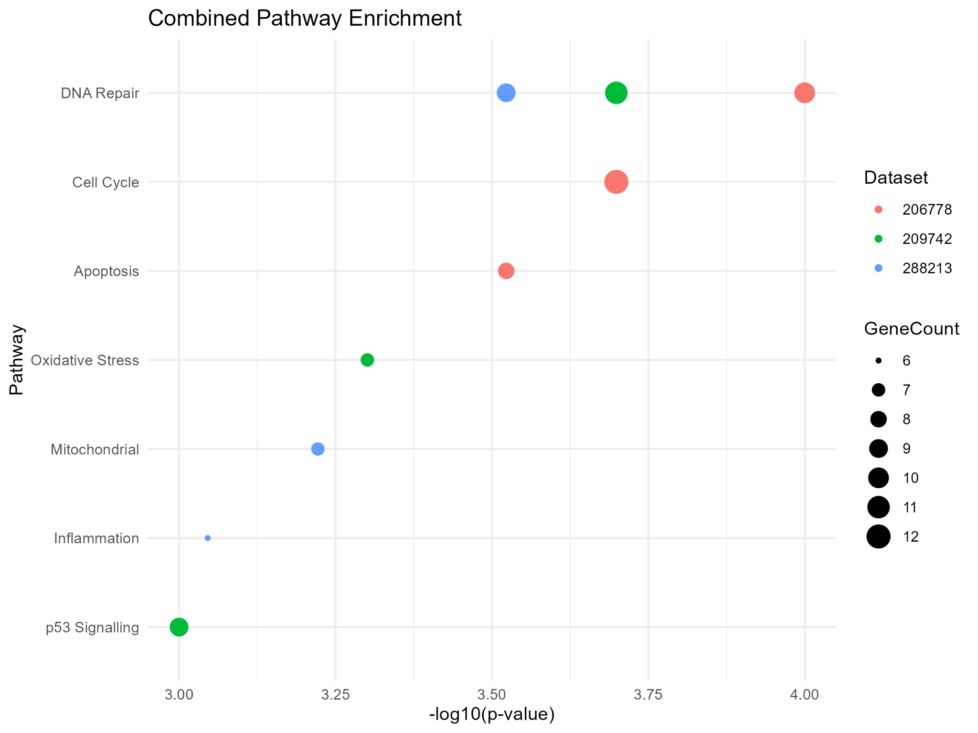
Combined Pathway Enrichment Across Datasets
This Dot Plot visualizes the significance (−log₁₀ (p-value)) and gene count (dot size) of key ageing and DNA damage pathways across all three datasets (color-coded). The plot confirms the core hypothesis: DNA Repair, Cell Cycle, and p53 Signalling are the most significantly perturbed pathways across the DNA damage models (GSE206778 and GSE288213), supporting the model that unresolved DNA damage triggers p53-mediated cellular stress.

Slide 19
Discussion
Key Ageing Pathways are Perturbed: Enrichment analysis confirmed that pathways central to the DNA damage response, including DNA Repair, Cell Cycle, and p53 Signalling, were the most significantly perturbed. This supports the conceptual model that unresolved DNA damage triggers p53-mediated cell cycle arrest and functional decline.
Predictive Biomarkers Identified: The Random Forest ML model successfully classified samples and identified a panel of highly predictive candidate biomarkers, including Zfp365 and Calm1. These genes, based on feature importance, are robust molecular markers that can distinguish DNA repair-deficient tissue and warrant further experimental validation.
Genomic Instability Drives Defect-Specific Signatures: The CSA KO model (GSE288213) showed a strong, stable upregulation of a specific gene cluster (Heatmap), consistent with severe TC-NER deficiency. Conversely, the ERCC1-XPF analysis (GSE206778) revealed minimal global DEG (Volcano Plot), suggesting a highly localized or tissue-specific transcriptomic response.

Slide 20
Conclusion
While the distinct nature of the signatures challenges the simple acceleration model, our findings reinforce the concept that genomic instability is a core driver of severe, unique pathologies by confirming the activation of established DNA damage and p53 mechanisms.

Slide 21
References
Dataset 1 Paper Link: https://pubmed.ncbi.nlm.nih.gov/38514641/
Dataset 2 Paper Link: https://pubmed.ncbi.nlm.nih.gov/40570619/
Dataset 3 Paper Link: https://pubmed.ncbi.nlm.nih.gov/37348497/
Background Figure Article: https://www.sciencedirect.com/science/article/pii/S0092867405001029#fig6

